Slide 1
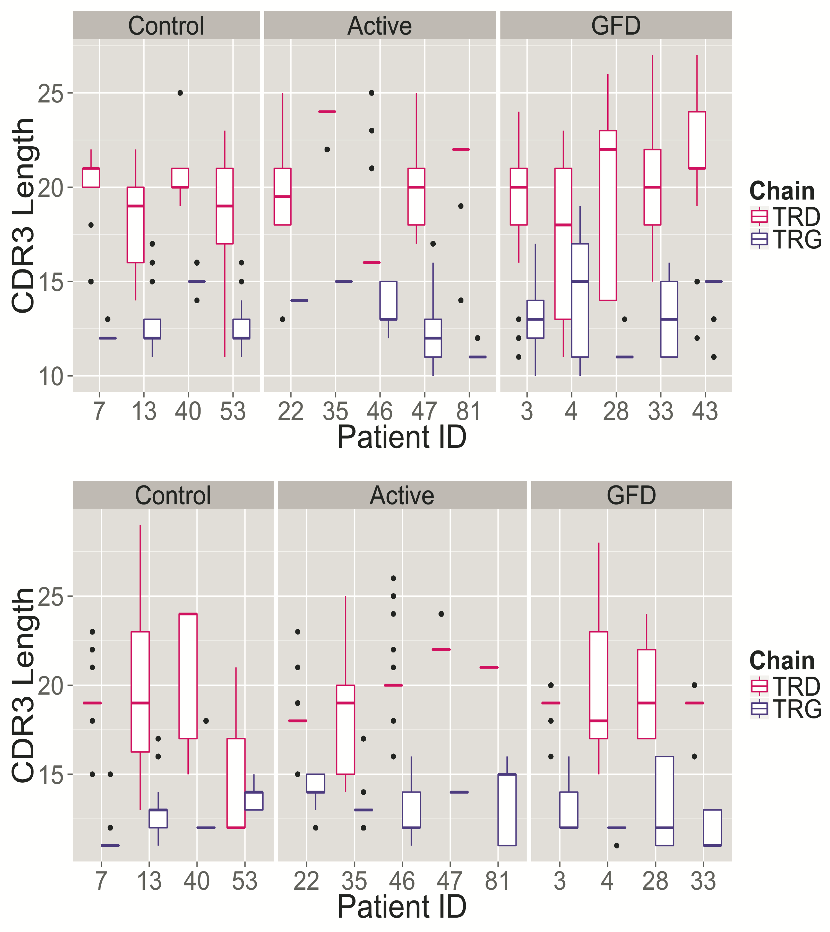
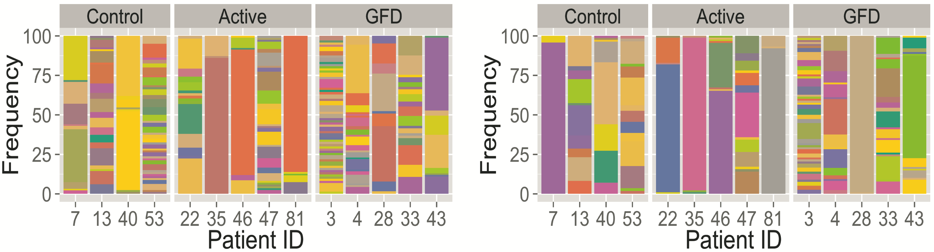
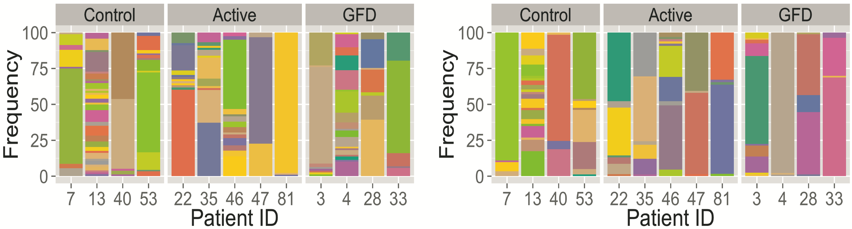
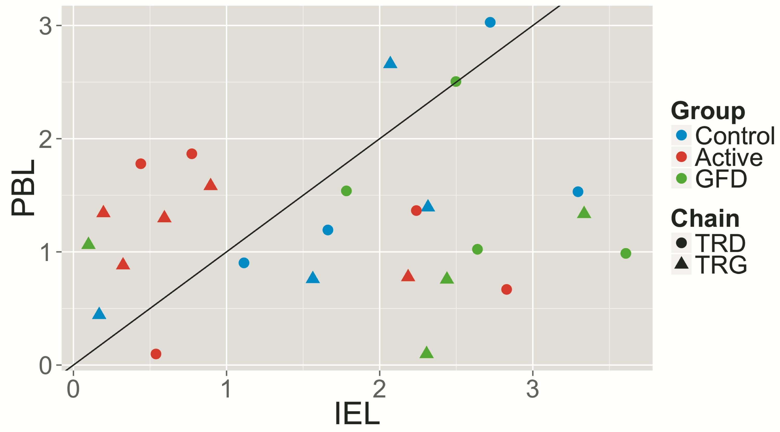
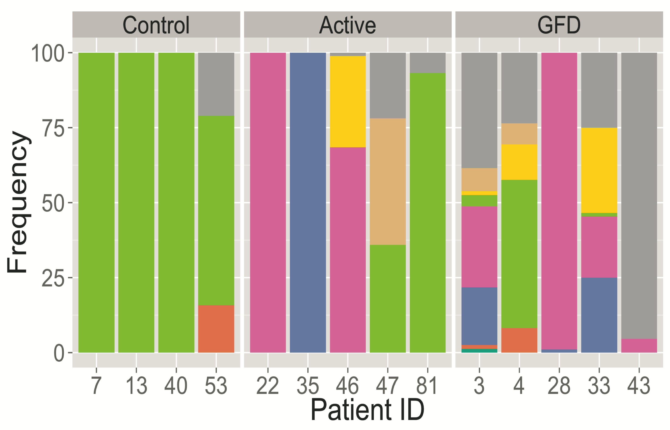

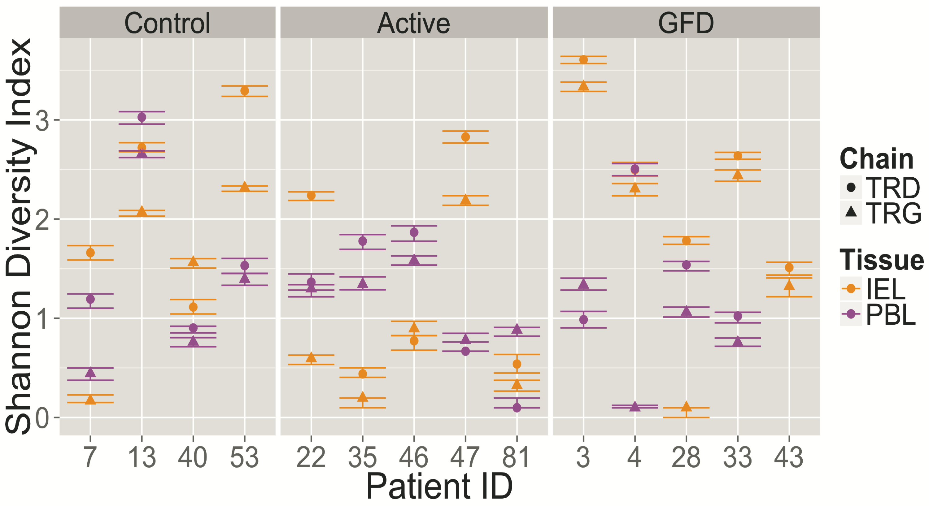
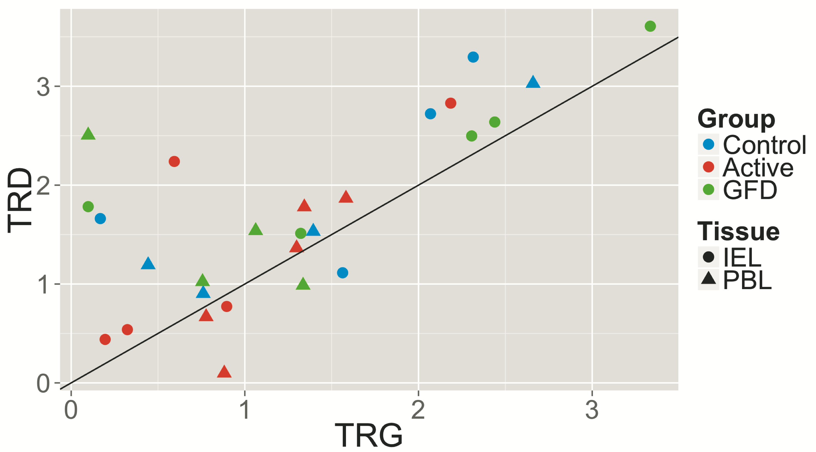
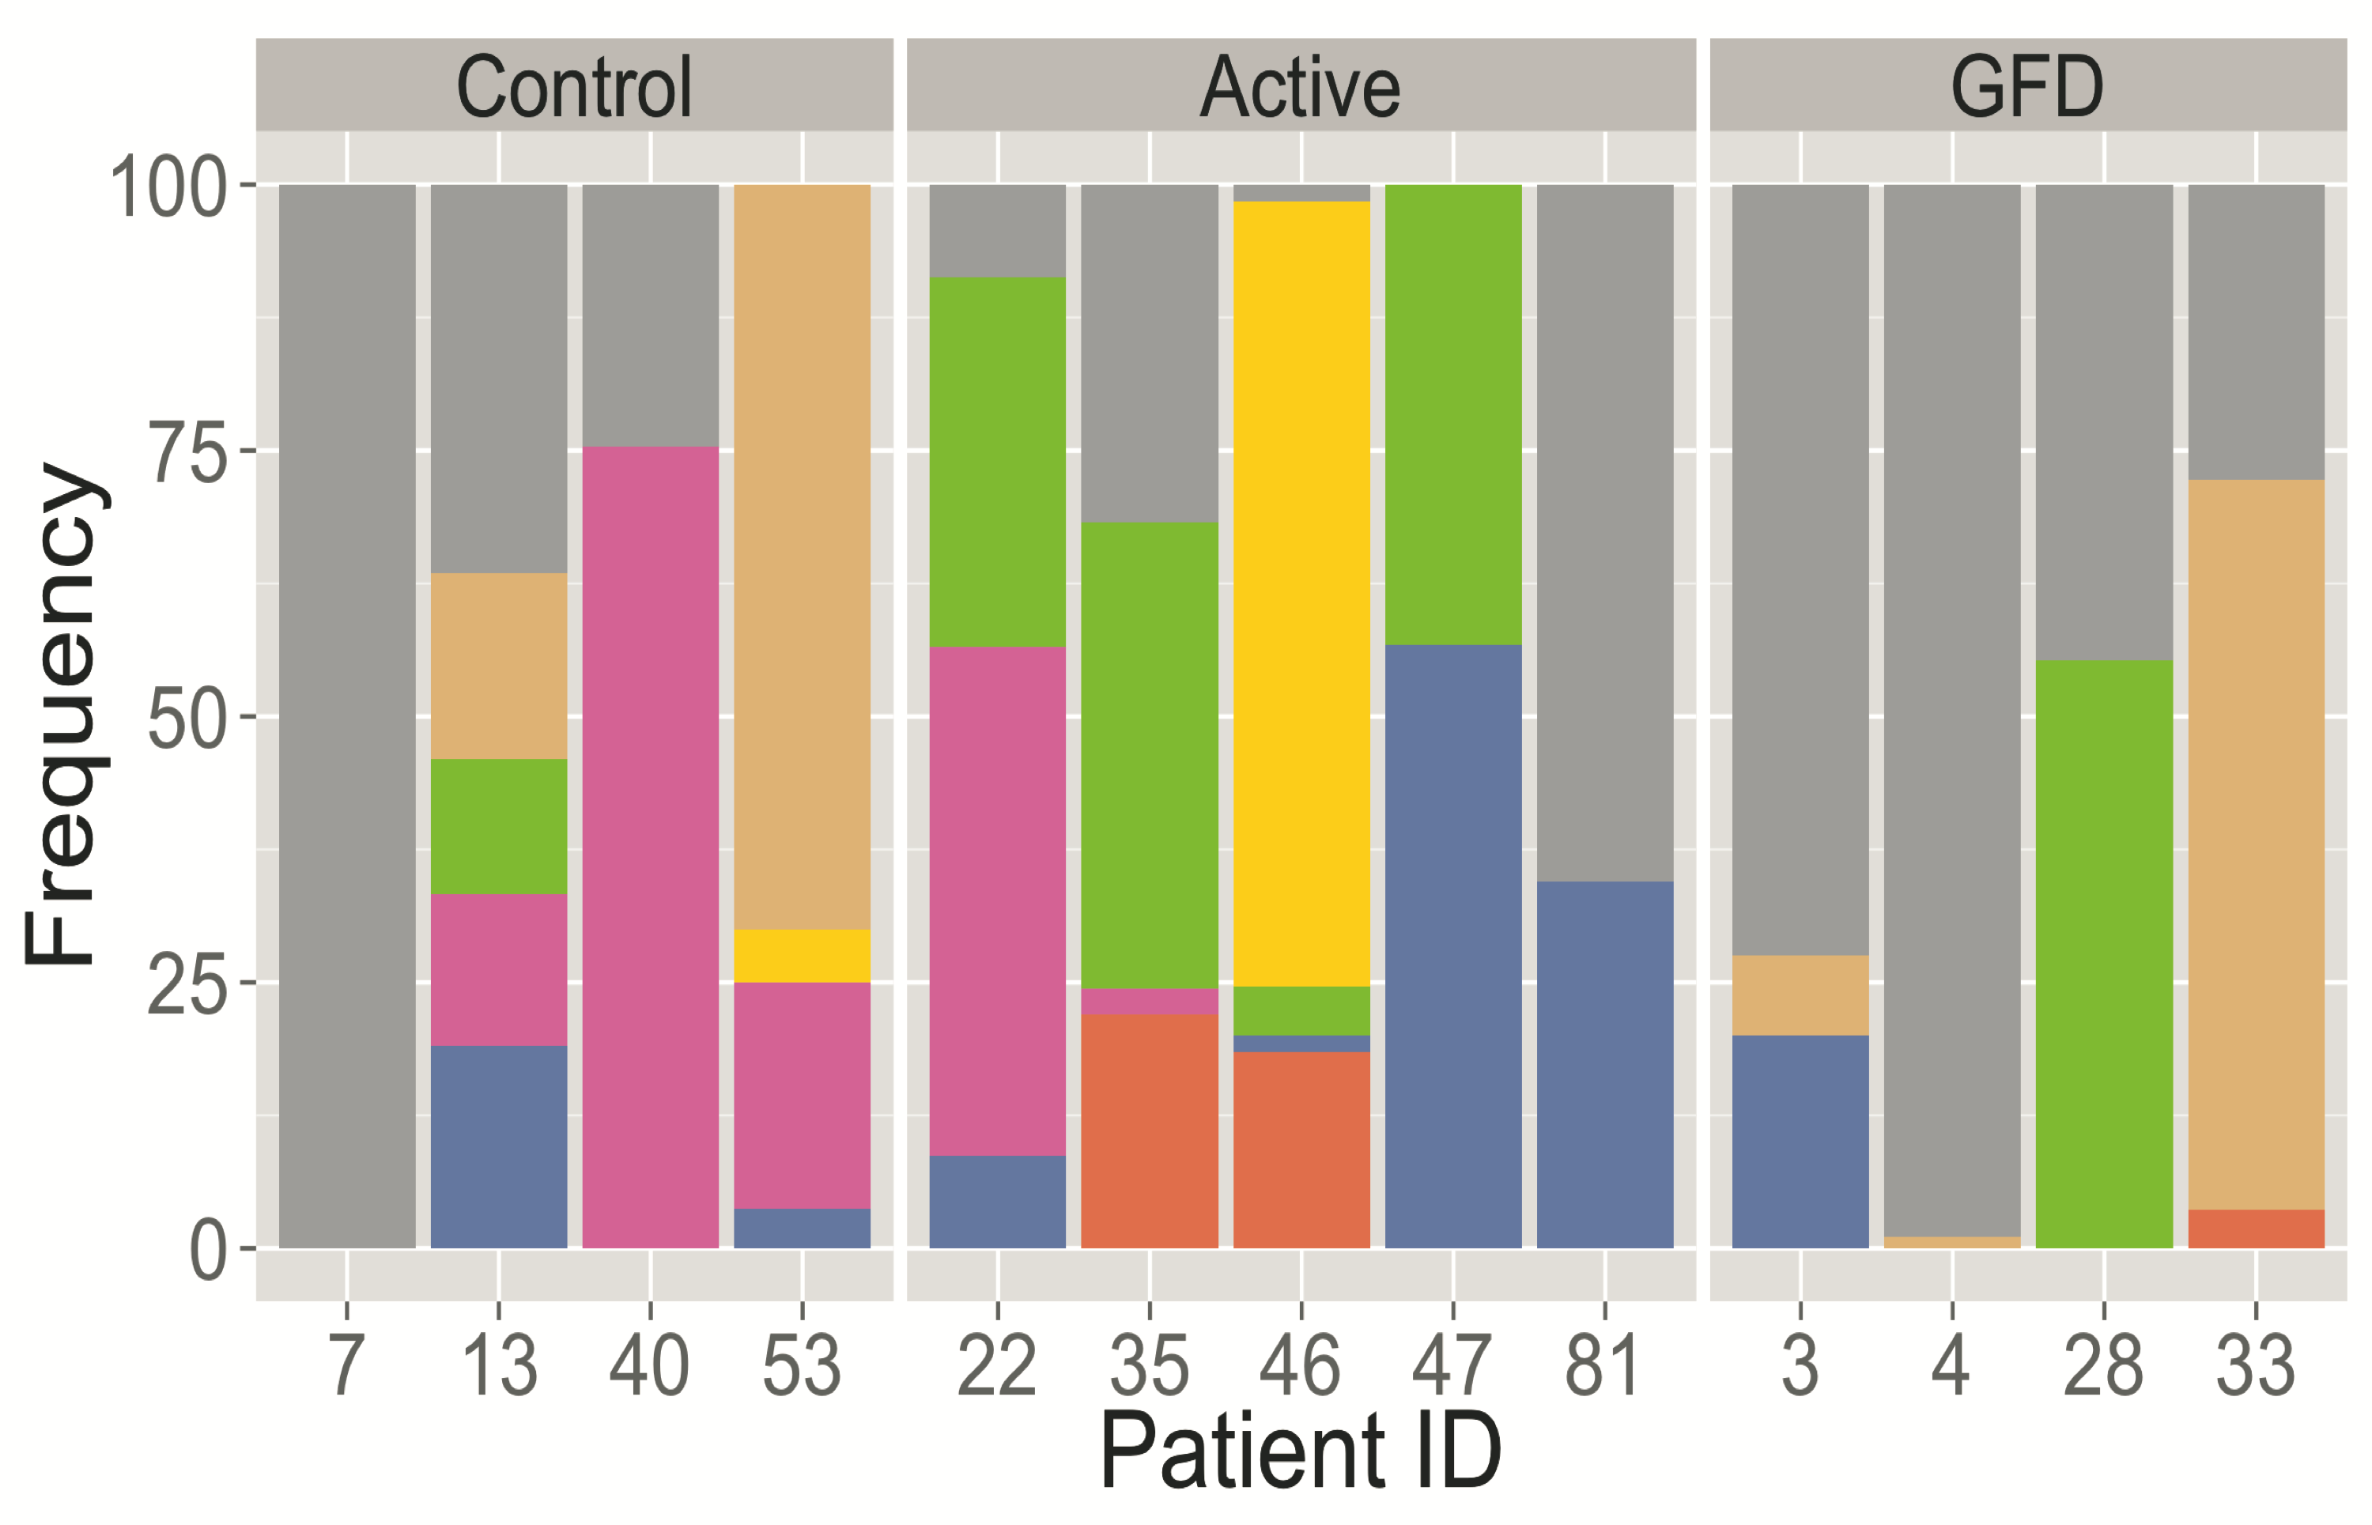
Characterizing TCR γδ T cells in tissues and disease
Mayassi T¹, Ladell K², Gudjonson H¹, Ciszewski C¹, McLaren J¹, Lesko K¹, Lawrence I¹, Sayegh H¹, Dinner A¹, Price D², Jabri B¹
¹University of Chicago; Chicago, USA. ²Cardiff University; Cardiff, Wales
Abstract
Gamma delta T cells are innate like lymphocytes that have been hypothesized to play a role in lymphoid stress surveillance. In this study, we investigate the hypothesis that the small intestinal microenvironment uniquely selects the repertoire and functional profile of TCR Vδ1 T cells under physiological and pathological conditions. To that end, we choose to use celiac disease (CD) as a model. In accordance with the literature, our data shows TCR γδ intraepithelial lymphocytes (TCR γδ IEL) are increased in frequency of CD3⁺ lymphocytes in the small intestine of patients with Active CD and treated CD (gluten free diet) when compared with controls. Our results indicate that the TCR repertoire of TCR Vδ1 IEL is unique when compared to PBL and overlap between individuals is dominated by the γ - chain. More specifically, we find Vγ4 is highly enriched in TCR Vδ1 IEL of controls when compared to CD patients suggesting a turnover in disease. Interestingly, only TCR Vδ1 IEL of Active CD patients have the capacity to produce IFN-γ when stimulated ex vivo. Therefore, we believe the intestinal microenvironment selects for a unique TCR Vδ1 IEL repertoire and imprints a unique functional profile on TCR Vδ1 IEL under different tissue states. Alterations to this repertoire and core program may give insights into the role of these cells in homeostasis and disease.
Results
A
B
Figure 1. Frequency of TCRgd T cell subsets based on expression of particular delta chains varies across tissues and disease states
Intraepithelial lymphocytes (IEL) and peripheral blood lymphocytes (PBL) were isolated from individuals and stained for the surface markers CD3 (UCHT1), TCRɣδ (SA6.E9), TCR αβ (IP26), Vδ1 (TS8.2) and Vδ2 (B6). A) Analysis of relevant populations shown as a % of total CD3 positive lymphocytes reveals a significant enrichment of TCRgd T cells in the duodenum of Active and GFD celiac patients. B) Further analysis of the IEL compartment shows no significant overrepresentation of a particular delta chain in disease when looking at the % composition of TCRgd T cells on a per chain basis. Box plots display the first and third quartiles and **p<0.01; ***p<0.001, using unpaired t test.
A
B
Delta Chain
Gamma Chain
IEL
IEL
Approach
TCR- Delta Chain
VD1
DN
VD2
Tissue
Blood
Intestine
Disease
Control
GFD
Active
PBL
PBL
C
D
TRVG
Methods
Human samples
Paired peripheral blood and duodenal biopsies were obtained from individuals that were then categorized as either Control, Active CD, or Gluten Free CD (GFD) based on serology reports and histological scoring of the duodenal biopsy (Data not shown).
Cell Isolation
Lymphocytes were isolated from peripheral blood (PBL) using ficoll separation, while intraepithelial lymphocytes (IEL) were isolated from duodenal biopsies using mechanical disruption coupled with EDTA.
Sorting strategy
TCRɣδ T cells were isolated as above, stained with relevant antibodies and sorted based on the expression of particular delta chains as shown in panel C below. This method was used to generate the data in Figures 1 and 2.
TCR sequencing
TCRɣδ T cells expressing the Vδ1 receptor (500-5,000 cells) were sorted as above and processed for TCR sequencing by template-switch anchored RT-PCR (see below) followed by high throughput sequencing. Sequences were analyzed with Sequencher software and the IMGT database.
IEL
TRVG
PBL
Figure 2. TCR ɣ and δ chains exhibit different patterns of diversity in tissues and disease
Vδ1 TCRɣδ T cells were ex vivo sorted and sequenced as described in the methods section. A) CDR3 lengths are displayed as box plots on a per individual basis for the corresponding tissue and chain. B) CDR3 diversity for the VD1 chain (left) and all corresponding gammas (right) are shown on frequency plots where every color is a unique CDR3 and the length of the color corresponds to the frequency of that given CDR3. Similar colors do not correspond to overlaps in CDR3 sequence. C) Shannon diversity indexes for each individual were calculated for each chain by subsampling 50 CDR3s (right) and plotted in two dimensions to look at how tissues segregate disease states (top) as well as how the chains compare across disease (bottom). D) Analysis of the the variable gamma region (TRVG) usage shown as a frequency plot where each gamma chain is assigned a color and the length of the colored bar corresponds to the frequency of that given gamma in a given individual.
A
B
C
TCRgd
VD2
Figure 3. TCRɣδ T cells exhibit a unique cytokine profile in the intestine of Active CD patients
Cells were isolated from peripheral blood and duodenal biopsies as described in the methods section. Cells were then treated with PMA/Ionomycin for 3hrs and subsequently stained for the cytokines IFN-g and TNF-a. A) Representative plot of IFN-g staining for Vδ1 TCRɣδ T cells from one Control and one Active patient. B) The frequency of IFN-g positive cells (top) and TNF-a positive cells (bottom) is shown for relevant cell subsets from the IEL compartment. C) The frequency of IFN-g positive cells (top) and TNF-a positive cells (bottom) is shown for relevant cell subsets from the PBL compartment. Box plots display the first and third quartiles and **p<0.01, using unpaired t test.
A
Control
0.71
Active
41.2
CD3
TCRab
DN
VD1
VD1
IFN-g
B
Conclusions
Vδ1 T cells bearing the Vγ4 chain are selected in the small intestine of controls suggesting homeostasis in the small intestine is driven by a ligand that involves recognition by Vγ4.
The shift in gamma chain usage and low diversity in Active CD coupled with a unique cytokine profile suggests the gamma chain may be implicated in recognition of a CD-associated ligand.
Future Directions
Further characterize Vδ1 T cells in the different disease states using ex vivo RNA-seq on small cell numbers
Go after the ligand by cloning tissue specific TCRs from different disease states and using TCR tetramer based approaches as well as computational approaches to model TCR structures.
C
Quigley, M et al. Current Protocols in Immunology. 2011
This project is primarily funded by NIH grant R01 DK6067180

